Slide 1
Video Game Sales and Ratings
By: The S.S. Minnow Johnson
Leon Luc, Tanner McKean, Patrick Tawil

Slide 2


Introduction
Goals of this study:
Predict global sales of video games
Understand which factors affect these sales

Slide 3
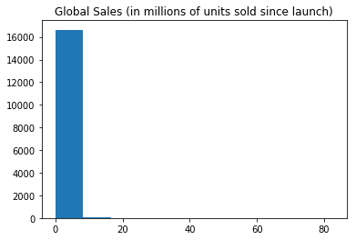
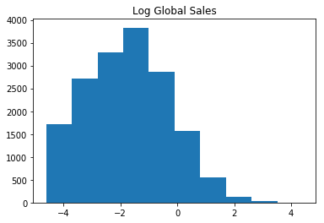
Exploratory Analysis
Global sales were very right skewed and not normally distributed
We took the log of global sales to have a more normal distribution

Slide 4
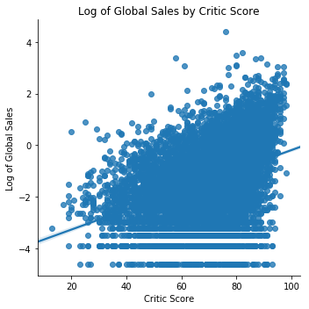
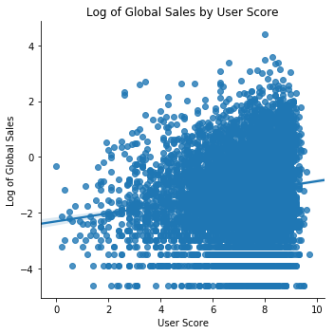
Exploratory Analysis
We can see that both critic score and user score have an effect on global sales
Critic scores seems to be more important than user scores

Slide 5
Model Results
Our final linear model consisted of user score, user count, critic score, and critic count
The most influential variable is critic score
For an increase of 1 in critic score, we expect a game to sell about 1.025 million more copies

Slide 6

Conclusions
What contributes towards global sales?
Game reviews (scores and counts)
Explains 20% of the variance
What can be improved?
More complete dataset
Merge with another dataset

